Slide 1

Evaluation of SHViT for Volumetric Semantic Segmentation in Industrial CT Scans
ChangGeng Drewes
Advisor: Martin Leipert

Slide 2
Agenda
01
Objectives
02
Dataset
03
Methodology
04
Experiment
05
Results and Discussion

Slide 3
Objectives

Slide 4
Objectives
Comparative analysis of various Vision Transformers configurations
Highlighting trade-offs between accuracy and memory efficiency
Optimize a Vision Transformer architecture for high resolution 3D-semantic segmentation

Slide 5
Dataset

Slide 6
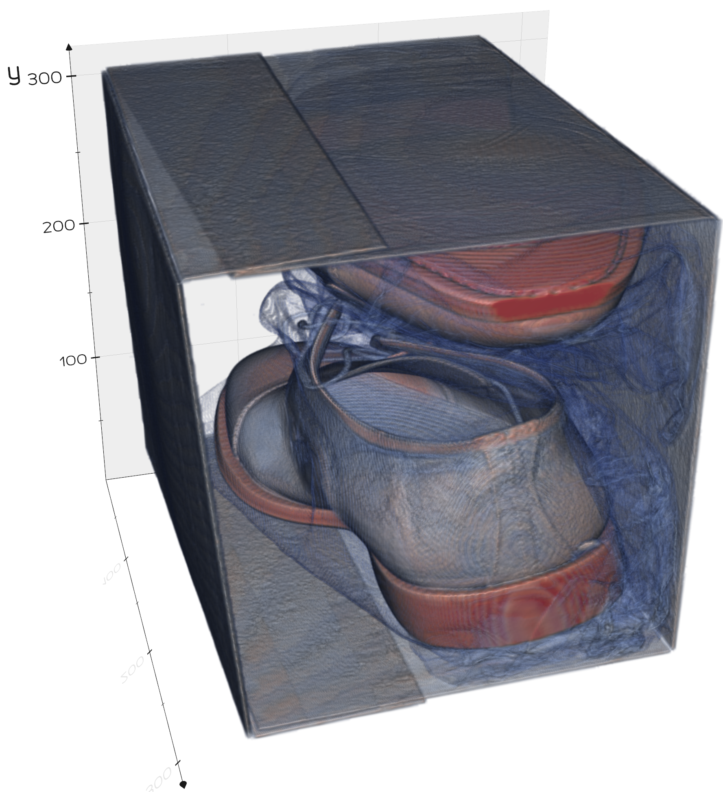
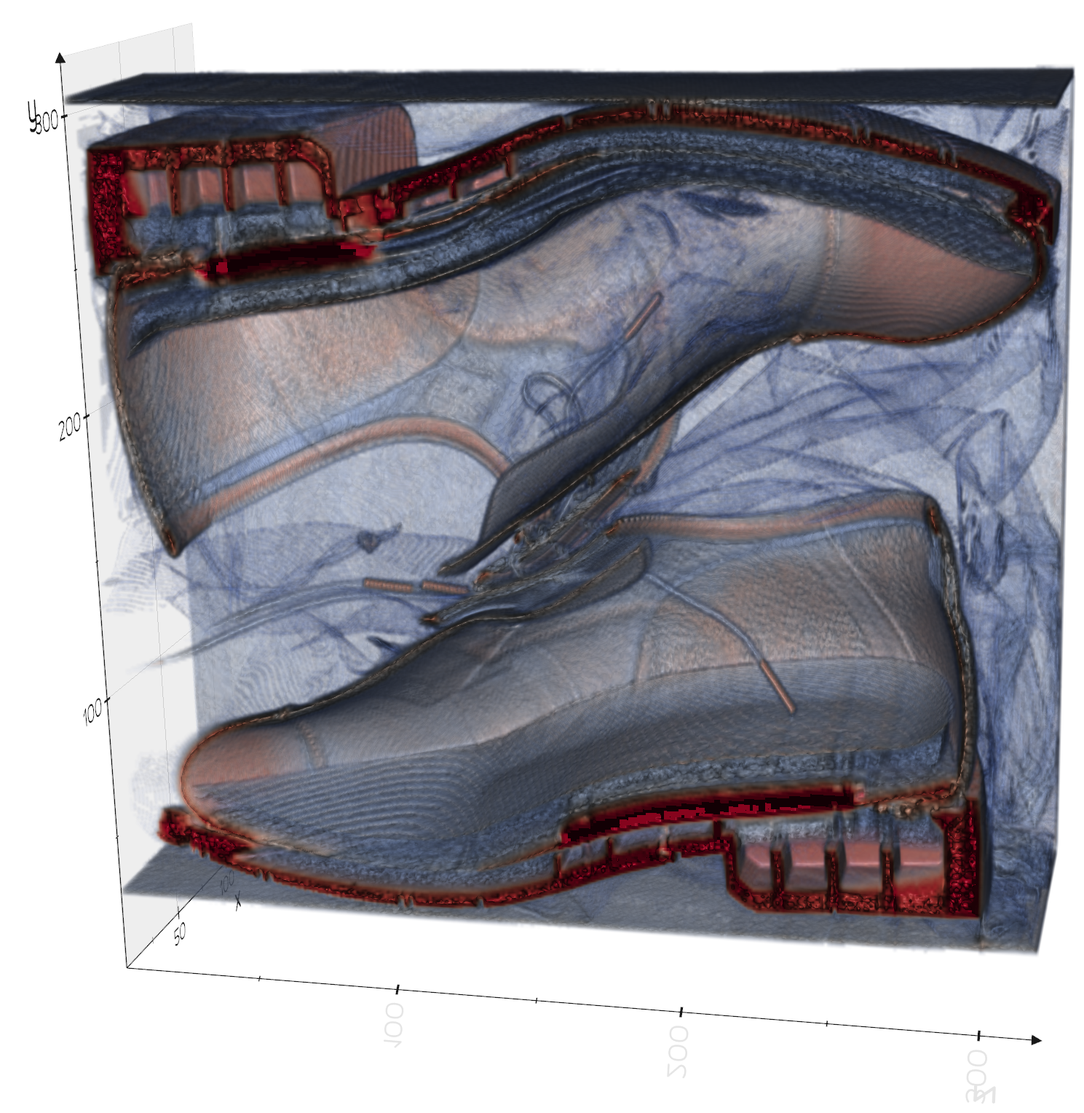
Dataset
40 high-resolution 3D CT-scans of shoes in boxes
corresponding ground-truth data with annotated segmentation labels
Volume dimensions of the scans
Ranging from (958, 410, 685) up to (1056, 1071, 1068)
„Bushi“-shoe

Slide 7
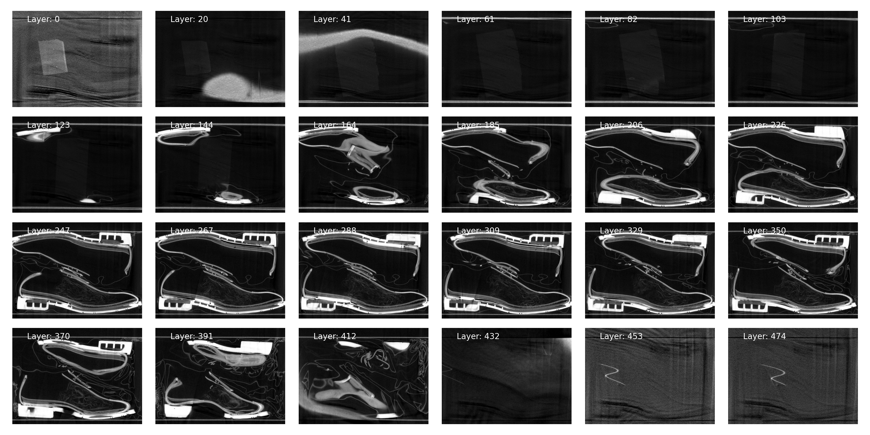
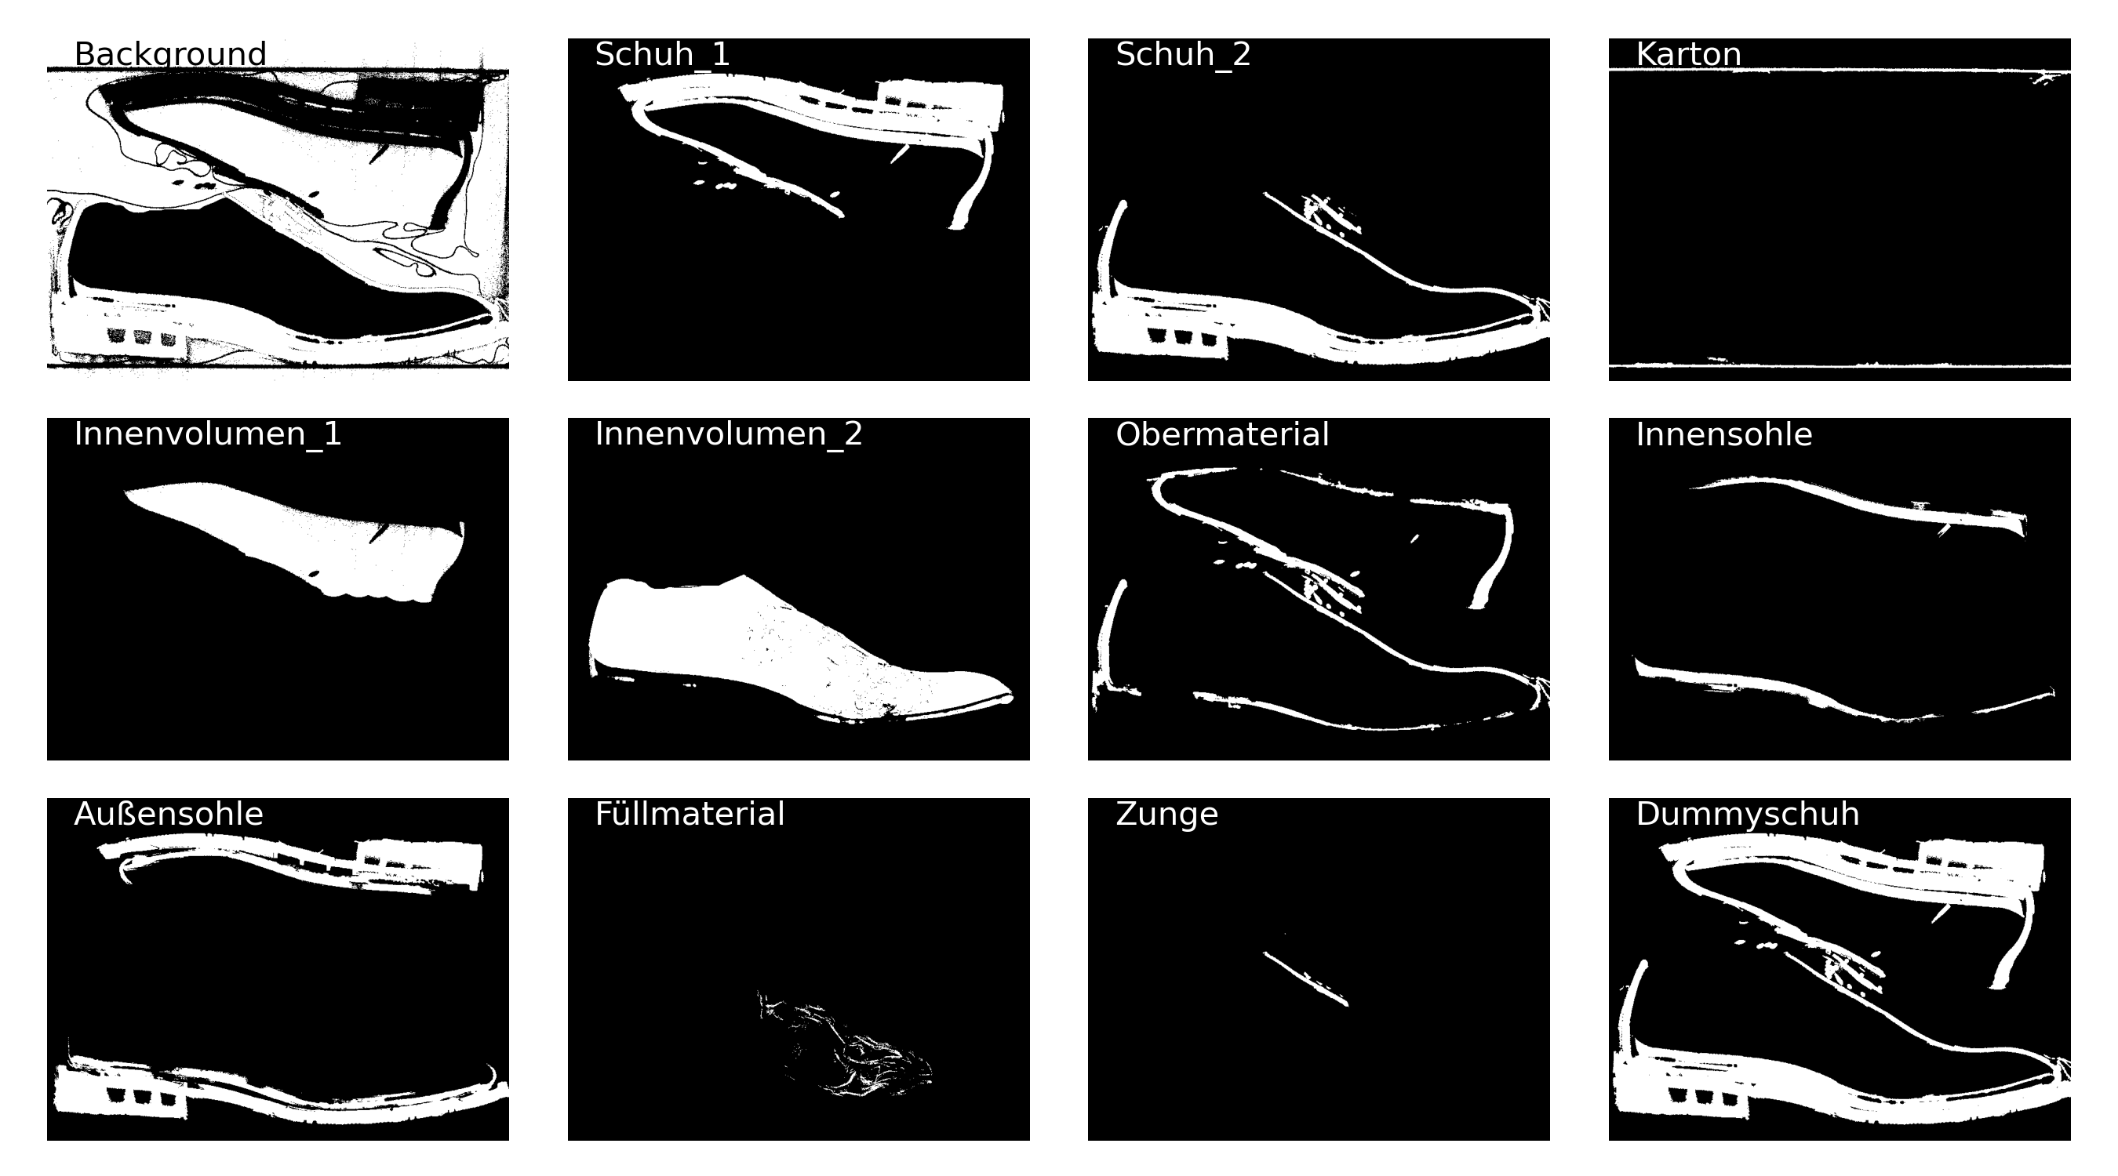
Dataset
Bruschi_down2_2_2.rek-File
with the resolution (876, 650, 475)
Shown are 24 different layers representing the 3rd dimension
Segment names of annotation files are
Background, Schuh_1, Schuh_2, Karton, Innenvolumen_1, Innenvolumen_2, Obermaterial, Innensohle, Außensohle, Füllmaterial, Zunge, Dummyschuh
Ground truth labels are
Karton, Außensohle, Innensohle, Obermaterial, Zunge, Füllmaterial, Background
Notes:
Images werden auf die gleiche Größe skaliert zB 224x224x224
Annotation Files auf werden auf 56x56x56
Die Helligkeiten werden zwischen 0 und 1 normiert
Dazu gehört auch 1-99 percentiles (1% auf 0 gesetzt und die Helligkeit die zu den 99% gehört, wird dann zu 1 gesetzt)

Slide 8
Methodology

Slide 9
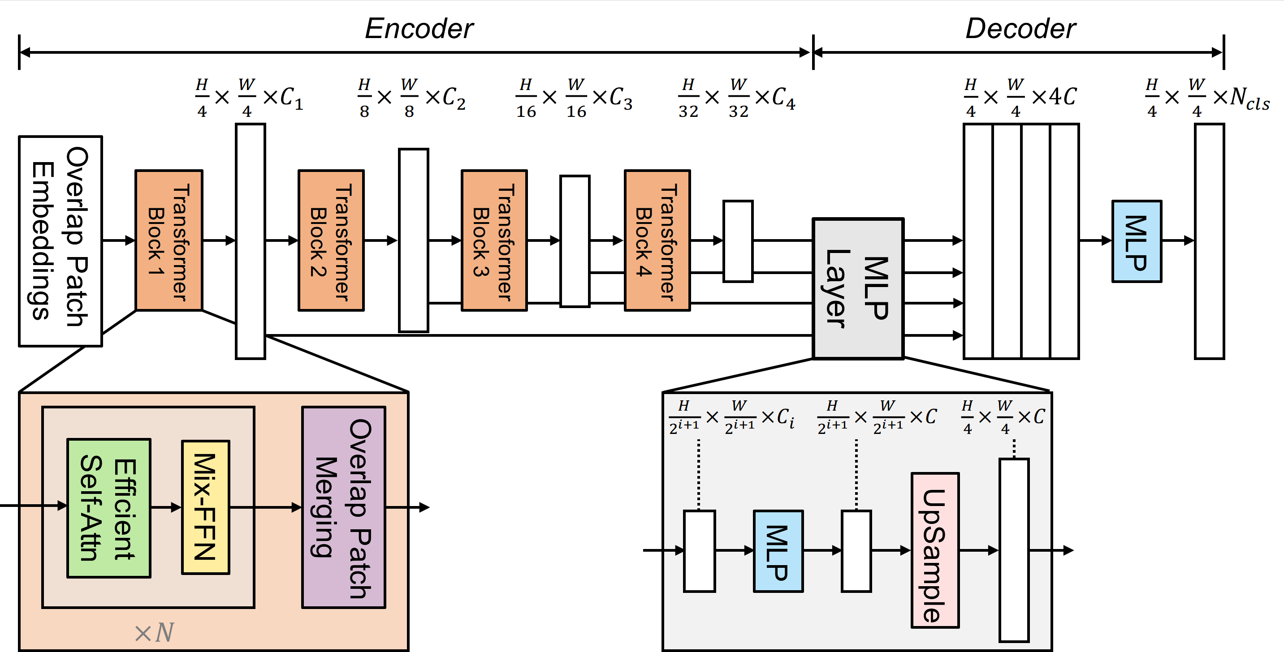
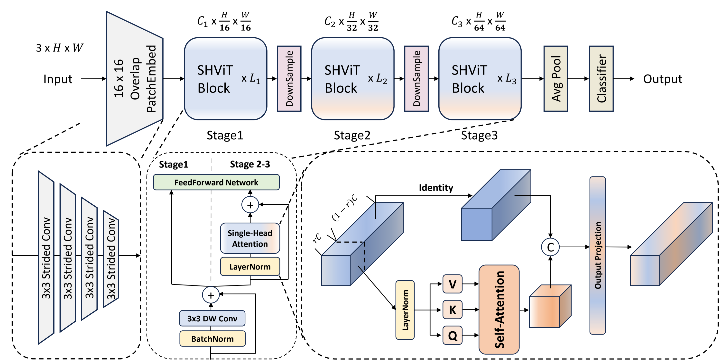
Architecture of MixViT and SHViT

Slide 10
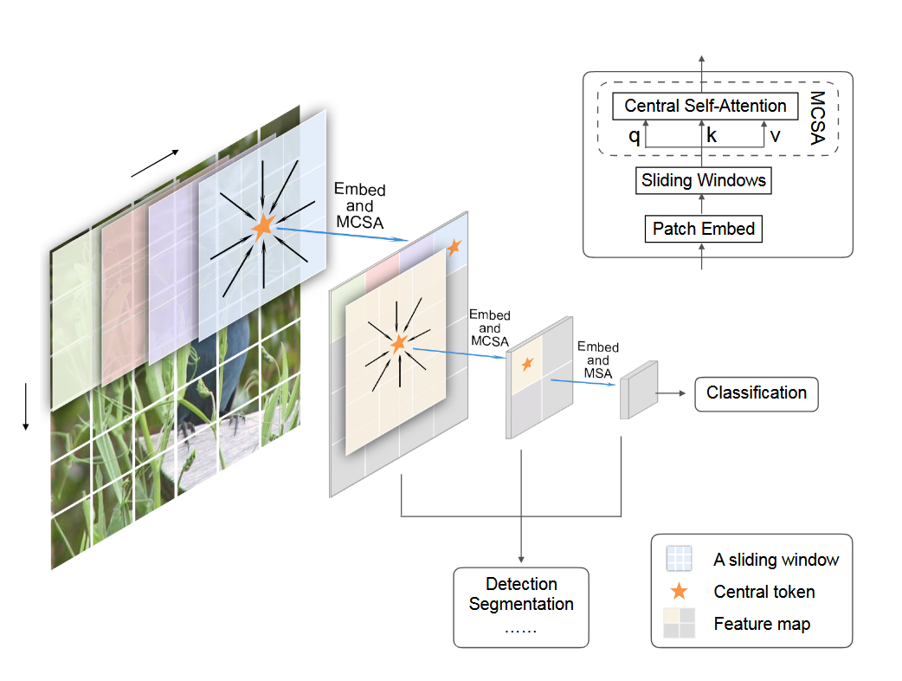
Central Self Attention
Attention Block with qk^{T} with O(n²)
Idea: use Central Self-Attention
(simViT Paper)
distant areas have weak relationships focus on local point and its immediate neighbors
-> Single head central self attention
Notes:
Von Stage 2 auf Stage 3 reduziert sich die Resolution von 28 auf 14
1. CNN uses weighted filters, Sliding Window uses Attention
On the other hand, CNNs have proved the importance of preserving the highly local relations with regional connections in convolution kernels.
Convolutions with sliding windows naturally capture the 2D spatial information without additional position encodings.
They applied overlapping sliding windows to establish cross-window dependencies
2. CNNs use shared weights, sliding windows work depending on data
...the computation of responses is only related to shared weights and ‘pixels’ within the same window.
Within each window, we propose MCSA to establish the highly local dependencies between the central patch and surrounding patches.

Slide 11
Experiment

Slide 12
Implementation
Data Generator / Data Loader
Load input data (image and annotation files)
Data Augmentation (rotation, flipping, brightness, contrast)
KFold-CrossValidation
Split: training / validation: 4/1 (k = 5)
Training
WarmUp (20 Epochs with Learning Rate Scheduler), Earlystopping (50 Epochs)
Best Validation Loss and F1-Score (Averaged)
Conducted each experiment six times
Final Output
Loss and F1-Score (Mean and standard deviation)
Notes:
For training: shuffle and augmentation
For validation: no shuffle and no augmentation
learning rate:
Wenn die Validationerror für eine gewisse Anzahl von Epochen, dann wird lr halbiert
Early stopping, wenn Valloss innerhalb 50 Epochen nicht besser geworden ist, dann wird training gestoppt

Slide 13
Experiment / Setup
Evaluate performance and efficiency of different 3D segmentation model configurations
Backbone Comparison
Compare Mix Vision Transformer (MViT), SHViT, and SHViT with Central Self-Attention (CSA)
Evaluation metric: Dice-Coefficient (F1-Score)
GPU memory consumption for efficiency analysis

Slide 14
Results and Discussion

Slide 15
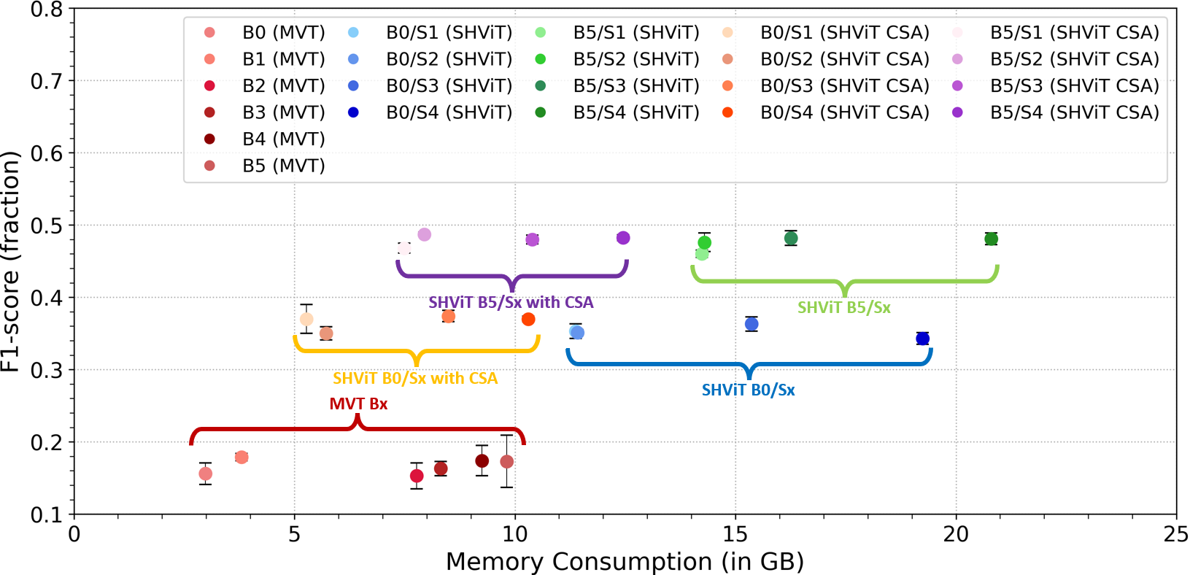
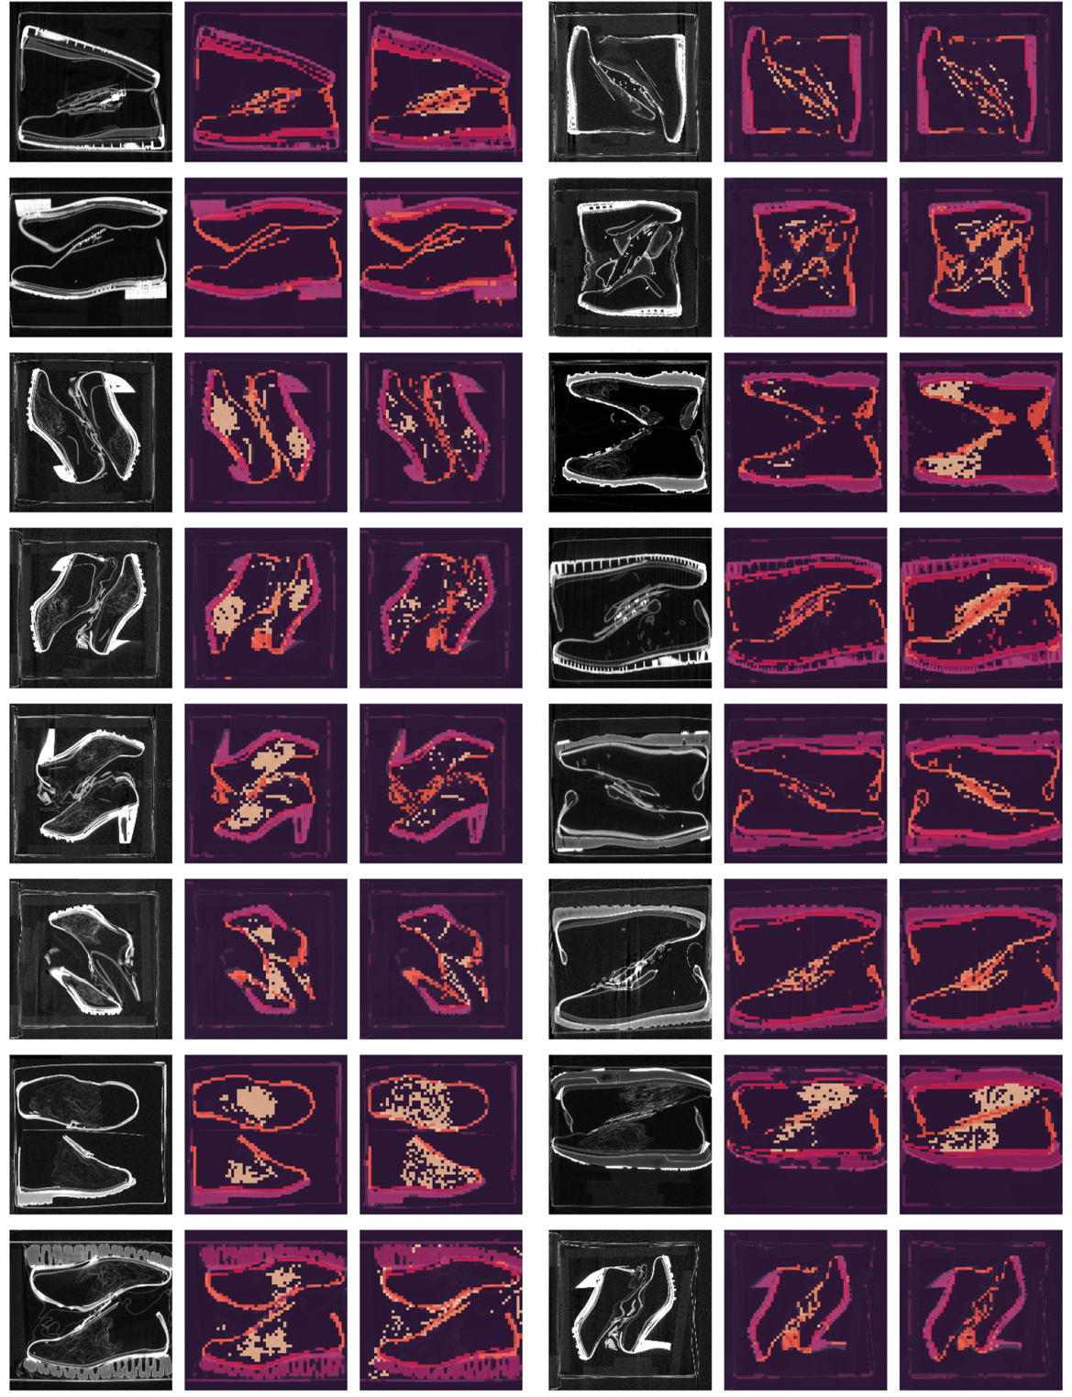
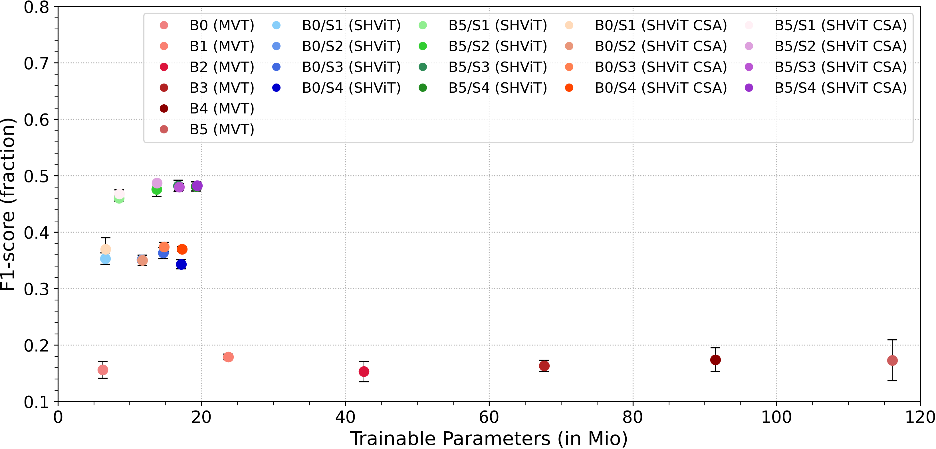
Results of the first experiment
Notes:
3D-SHViT model with central self-attention
From left to right: the input image, the predicted segmentation, and the corresponding
ground truth segmentation image for each of the two columns.

Slide 16
Next steps …

Slide 17
Next steps
Evaluating Maximum Volume Size for SHViT on a 24 GB GPU
Impact of Convolutional Depth (number of layers) on F1-Score
Effects of Kernel Size on F1-score and Memory
Segmentation performance: SHViT versus CNN (Martins Paper)
Notes:
"mit_b5": {
"embed_dims": [64, 128, 320, 512],
"depths": [3, 6, 40, 3],
"decode_dim": 768,
},
"SHViT_s2": {
"embed_dims": [128, 308, 448],
"partial_dims": [32, 66, 96],
"depths": [2, 4, 5],
"types": ["i", "s", "s"],
},

Slide 18

Thanks for your attention

Slide 19
Backup

Slide 20
Memory consumption in attention block
Example with an input shape: (224,224,224)
Problem:
After Overlap Patch Embedding Block: (56,56,56)
After Stage 1: (28,28,28) [is input size into stage 2]
Stage 2 with attention block:
q, k,v with each dimension: (…, 28,28,28)
After flattening the spatial dimensions, the shapes become:
q, k, v shape: (…, 21952)
q^T*k : 21952 * 21952 = 480 Million elements (a lot)
For an input image shape (448,448,448) then q^T*k = 30,840,979,456 = 31 Billions elements
-> Solution (applying central self attention)
Notes:
Grenze mit sw: 320, 320, 320
Grenze ohne sw: 224x224x224
Solution (applying central self attention)

Slide 21
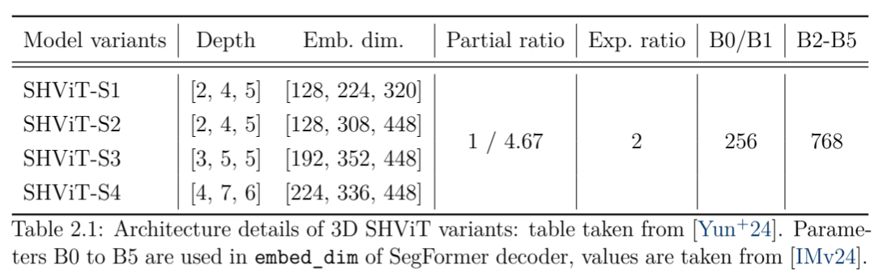
Architecture details of 3D SHViT variants

